Slide 1
WRCCDC Black TEAM DEBRIEF
Congratulations, we wON!

Slide 3
We are Black Team
Systems optimized for your convivence
All systems worked
Host naming was Xena Warrior Princess
Daddy ‘Tops

Slide 4
The Team
Like to thank my core black teamers who helped every day to make sure this event happened
Many new black teamers (6 in total!) and always happy to have more
We are not your enemy. We are here to help you.
Huge effort this year to integrate, test, and verify everything by all team members.
We get paid in chuckles (still)!

Slide 5
Many Hours
7AM to 3AM
Multiple days of all nighters

Slide 7
Lessons Learned
Negatives
Positives
Teams struggled with routers
Windows Updates, *nix Updates not cached and were most of our bandwidth
Could not serenade teams with wonderful music and memes
Did not provide teams with access to snapshots (Oops)
First year we have had multiple boxes with 12GB of RAM+ used/required
Aged network to perfection for ~6 months
Ticket system allows for teams to validate and audit issues
Very good performance and connectivity

Slide 8
Network Review

Slide 9
Network Review

Slide 11
Hosts

Slide 12
And then Triassic Land

Slide 13
Topology
3x3 Site to Site VPNs on the first day (full mesh)
HBC Moved as part of a “Data Center Migration” in competition
Network doing an average of each team doing about 12mbps for the entirety of competition
Conditional Trusts on all domain controllers, separate users
Skype for Business and Outlook/Exchange functional and used

Slide 14
Custom Services
Had a forensics challenge in the competition for the first time
4 custom written applications
Unified Systems Windows Apps
Park Fence Controller
Park Home Page
Park Sales Site

Slide 15
Monitoring

Slide 16
Spam 4U

Slide 17
Determine What is Important
Certificate Authority
Git Repos (With our custom software)
Domain Controller (maybe?)
Exchange

Slide 18
Strategy?
Only 4 teams asked for scrubs
We forgot flash drives… We didn’t know till 2:30 PM on Saturday
If black team suggests a consult… You probably should take us up on the offer.
Data Center migration was there to help you

Slide 19
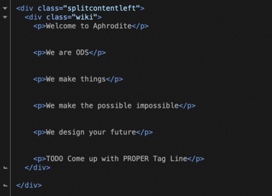
Optimal hardware
Coco / The Router Guy
Very very sketchy cameras
Very good hypervisors

Slide 21
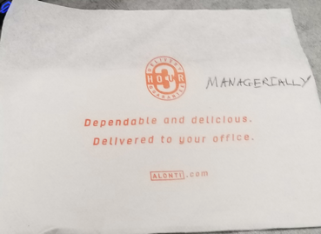
Access
Teams asked us to debug issues without access. Thankfully Red Team provided us with access to the teams
Cameras were being monitored, some teams got creative about privacy

Slide 22
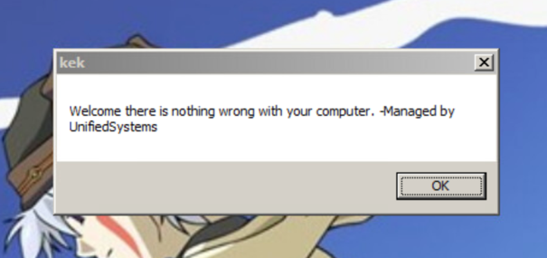
Optimal Systems

Slide 26
Blue Team Blues
Teams struggled with default credentials well into the second day
Teams struggled with routers
Teams not willing to scrub/get consult (hint: usually less of a point loss)
Teams struggling with troubleshooting connectivity issues
Guest WIFI?
Playing Halo while in competition

Slide 27
PAN to Pi and CISCO TO JUNIPER

Slide 28
Default SSH KEY
If we can still get in, red team can still get in

Slide 30
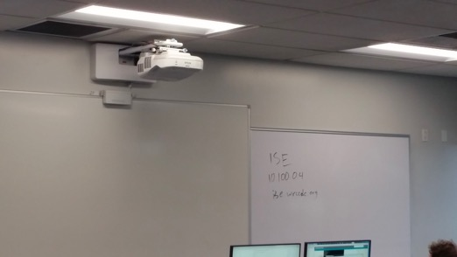
Documentation is Key

Slide 31
TAQUERIA DE MEXICO

Slide 32
Thoughts from Black Team
Tickets are your friend – two teams submitted issues were tracked and resulted in point changes to their benefit
Ask for help quicker!

Slide 33
We are Consultants..

Slide 34
And here We are

